Slide 1
Economic Freedom of North America: Overview
Dean Stansel
Research Associate Professor
O’Neil Center for Global Markets and Freedom www.deanstansel.com www.oneilcenter.org

Slide 2
Economic Freedom of North America (EFNA)
Fraser Institute’s ranking of the U.S. states and Canadian provinces.
First published in 2002.
The 2015 report was the 11th edition.
  Included Mexican states for 2nd time.
I have been the primary author of the last three editions.

Slide 3
EFNA Impact
Has been cited in over 200 academic journal articles and policy papers.
Compared to other state indices:
  Has been produced the longest
  Is the only one updated annually
  Has the most years of data (33)

Slide 4
Area 1: Government Spending
1A: General Consumption Expenditures, % of Income
Total expenditures minus transfers
to persons, businesses, & governments, and interest on public debt
1B: Transfers & Subsidies, % of Income
Includes: Welfare Payments, Grants, Agricultural Assistance, Food-stamp Payments, and Housing Assistance
1C: Insurance & Retirement Payments,
% of Income
Includes: Employment Insurance, Workers Compensation, & pension plans

Slide 5
Area 2: Taxes
2A: Income & Payroll Taxes, % of Income
Personal & Corporate Income Taxes & Payroll Taxes
2B: Top Marginal Income Tax Rate and the Income Threshold at Which It Applies
2C: Property Taxes & Other Taxes, % of Income
All taxes other than income, payroll, & sales
2D: Sales Taxes, % of Income
All Sales & Gross Receipts Taxes (includes excise taxes on specific goods)

Slide 6
Area 3: Labor Market Freedom
3Ai: Minimum Wage Annual Income,
% of Per Capita Personal Income
3Aii: Government Employment as a Percentage of Total Employment
3Aiii: Union Density
(percentage of employees who are unionized)

Slide 7
Calculations
Each variable given value b/w 0 and 10
  score = ((Max-Obs)/(Max-Min))*10
Each variable equally weighted within each area
Each area equally weighted
Overall score is average of 3 area scores

Slide 8
Best & Worst (US States)
Most Free Least Free
1-New Hampshire 50-New York
2-South Dakota 49-California
3T-Texas 48-Alaska
3T-Florida 46T-Hawaii
5-Tennessee 46T-New Mexico
6-Virginia 43T-West Virginia
7T-Missouri 43T-Kentucky
7T-Nebraska 43T-Vermont
9T-Arizona, Maryland, 40T-Mississippi
North Dakota, 40T-Oregon
Colorado, & Kansas 40T-Ohio

Slide 9
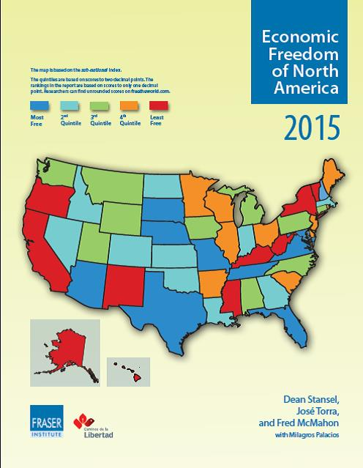

Slide 12
Per Capita Income Is Much Higher in States with Higher Economic Freedom
Most Free ……………. Least Free

Slide 13
Per Capita State Income Growth Is Positively Correlated with Economic Freedom

Slide 14
Economic Freedom of North America: Overview
Dean Stansel
Research Associate Professor
O’Neil Center for Global Markets and Freedom www.deanstansel.com www.oneilcenter.org

